Slide 1


K.RAMAKRISHNAN COLLEGE OF TECHNOLOGY
(AUTONOMOUS), TRICHY
INTELLIGENT SIGN LANGUAGE RECOGNITION AND TRANSLATION
PRESENTED BY GUIDED BY
LOKESHWARAN V -2403811724321057 Ms. ADEEBA AAISHA F
MAHALAKSHMI K R -2403811724322058 TA /AIDS
MERLIN F -2403811724322060
MITHUN AKASH M -2403811724321061

Slide 2
PRESENTATION OVERVIEW
Abstract
Objective
Architecture diagram
Literature survey
Research methodology
Existing system
Proposed system
Conclusion
Future enhancement

Slide 3
ABSTRACT
This project develops an Intelligent Sign Language Recognition and Real-Time Translation System using deep learning and computer vision. The system captures hand gestures through a camera, recognizes signs, and converts them into text and speech in real time. It helps reduce communication barriers and provides an easy, accessible solution for sign-language users.

Slide 4
OBJECTIVE
> Detect hand gestures using computer vision.
> Recognize signs using deep learning.
> Convert gestures into meaningful text.
> Generate speech from translated text.
> Provide fast and accessible communication.

Slide 5
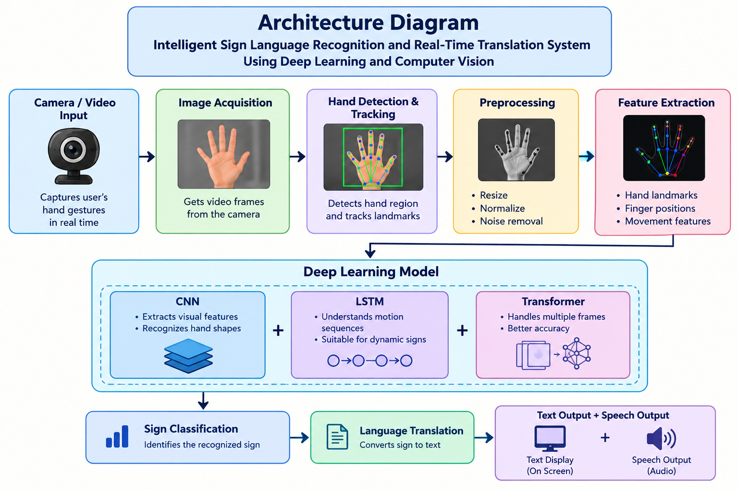
ARCHITECTURE DIAGRAM

Slide 6
LITERATURE SURVEY
Smart_Cargo_Literature_Survey.xlsx

Slide 7
RESEARCH METHODOLOGY
> Data Collection – Collect sign language images/videos.
> Preprocessing – Resize and clean the input data.
> Feature Extraction – Detect hand landmarks using computer vision.
> Model Training – Train a deep learning model to recognize signs.
> Sign Recognition – Identify the input gesture in real time.
> Translation – Convert the recognized sign into text and speech.
> Evaluation – Test the system for accuracy and real-time performance.

Slide 8
EXISTING SYSTEM
> Sign language translation is often done manually by human interpreters.
> Some existing systems recognize only limited hand gestures or alphabets.
> Many systems work in controlled environments with good lighting.
> Real-time sentence-level translation is limited.
> Some solutions require special sensors or wearable devices.
> These limitations make sign-language communication less convenient and accessible.

Slide 9
PROPOSED SYSTEM
> Camera captures the user's hand gestures.
> Computer vision detects the hand.
> Hand landmarks/features are extracted.
> Deep learning model recognizes the sign.
> Recognized sign is converted into text.
> Text is converted into speech.

Slide 10
CONCLUSION
> AI and computer vision can make sign-language communication easier.
> Deep learning helps recognize static and dynamic gestures.
> The proposed system provides real-time text and speech translation.
> It can support inclusive and accessible communication.
Notes:
10

Slide 11
FUTURE ENHANCEMENT
> Support multiple sign languages.
> Translate complete sentences.
> Improve real-time accuracy.
> Develop a mobile app.
> Add offline translation.
> Integrate voice and AR/VR.

Slide 12
THANK YOU

